Slide 1
NZISM Wellington Branch Knowing your risk management landscape
Prepared by: Michael Jones | January 2019 | Version 1.0

Slide 2
Legislative requirement
Positive “due diligence” duty to ensure PCBU has either
eliminated risks to health and safety “so far as is reasonably practicable”, or
Where risks cannot be eliminated, minimise them “so far as is reasonably practicable”.

Slide 3
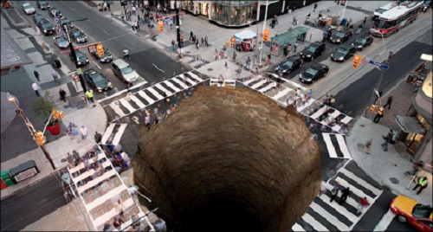
Hazard identification – risk assessment
Is there a difference between hazard and risk?
For a given hazard, is the risk always the same?
Hazard – hole in the ground
Risk – likelihood and consequence from falling into the hole

Slide 4
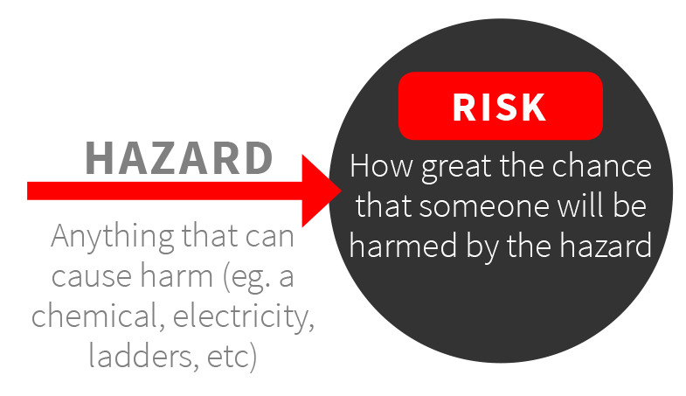
Hazard identification – risk assessment
Hazard identification alone does not help in the prioritisation of…
Time
Effort
Resources
Risk provides insights as to where attention should be given
Focus on that which is important as opposed to ‘just interesting’

Slide 5
Hazard identification – risk assessment
When assessing consequence and likelihood, organisations frequently use a Risk Matrix… This Risk Matrix will reflect your organisation’s risk appetite.
Event classification | Consequence
 | Insignificant | Minor | Moderate | Major | Catastrophic
Occupational safety and health | Any injury not requiring treatment by medical professional. | Lost time injury directly attributable to organisational or mechanical failure. | One or more serious harm injury or LTI directly attributable to organisational, or mechanical failure. | One fatality directly attributable to organisational, or mechanical failure. | Multiple fatalities directly attributable to organisational, or mechanical failure.

Slide 6
Personal opinion - risk matrix numbering is important
Is an annual first aid injury = single fatality every 11+ years?

Slide 7
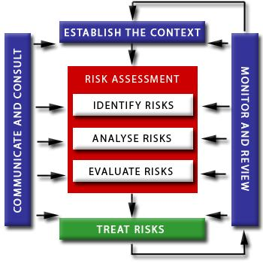
Hazard identification – risk assessment
Risk assessment language…
Inherent risk
Current controls
Residual risk
Planned controls
Formal hazard ID
Consequence
Likelihood
Controls

Slide 8
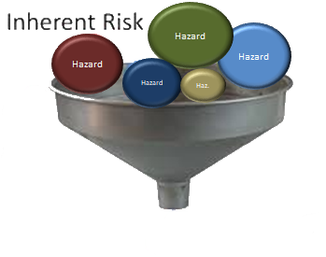
Hazard identification – risk assessment
Inherent risk
Assess the risk of the task without any controls being in place by…
Assessing the credible consequences following exposure to the hazard
The likelihood of that exposure occurring
Task

Slide 9
Hazard identification – risk assessment


Slide 10
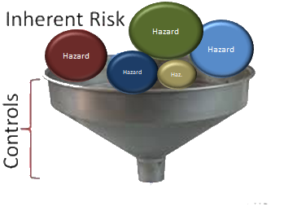
Hazard identification – risk assessment
Then we need to…
Identify the controls already in place or will be introduced to manage (treat/mitigate) the identified hazard(s)
Task

Slide 11
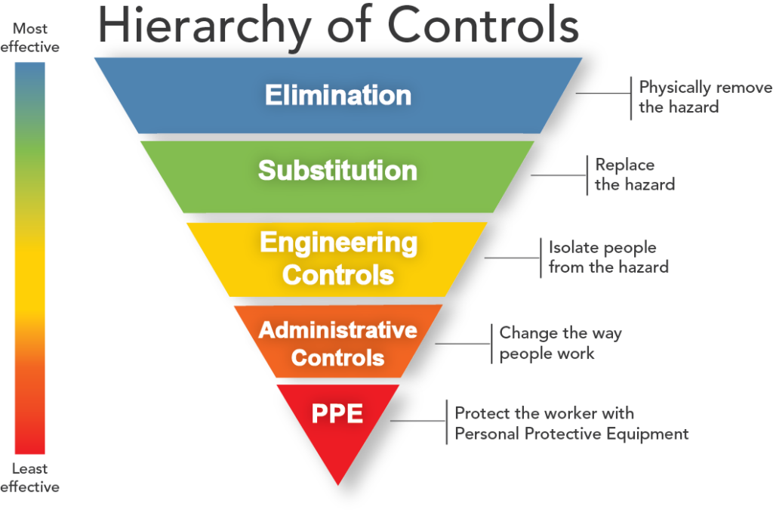
Hierarchy of control measures

Slide 12
Types of controls to be considered
As the inherent (uncontrolled) risk level increases, the robustness of the controls should also increase.
Lock-out/tag-out
Work permit
Fail safe designs
Physically engineered isolations etc.
Isolation – covers, barriers
Engineering controls – guarding, micro-switches, alarms, etc.
Personal Protective Equipment, Administrative controls,
Safety signage, etc.

Slide 13
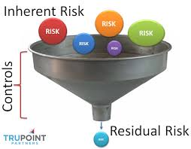
Hazard identification – risk assessment
We then need to…
Re-assess the risk of the task with the controls being in place. This is the residual risk.
Task
Hazard
Hazard
Hazard
Hazard
Haz.

Slide 14
Hazard identification – risk assessment
❹
Inherent risk
❶
❷
Residual risk
❸
❶
❸
❷
❹
Always look out for ‘Black Swan’ events – often dismissed or under estimated

Slide 15
Hazard identification – risk assessment
Inherent

Controls
Residual
◉

Slide 16
Remember - risk is not static
Hazard identification – risk assessment
Incident
HAZARDS

Slide 17
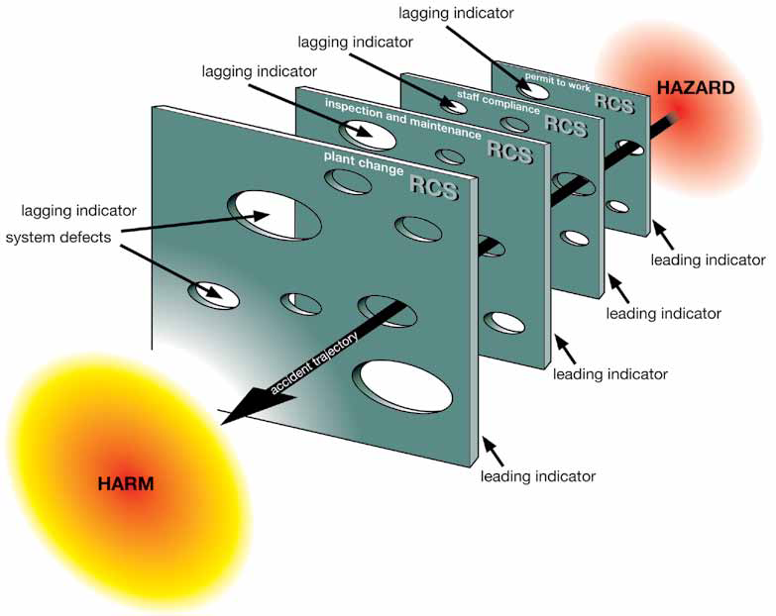
Linkage of risk with auditing and performance indicators
Audits / check sheets/observations
Layers of protection
Controls
Incident reports
James Reason’s model – anatomy of error model

Slide 18
Residual risk levels used to establish risk acceptance criteria
Intolerable
Acceptable only if level of risk is acceptable and cannot be reduced further without disproportionate expenditure for the level of risk reduction
Broadly acceptable
Note: When members of the public are involved, they are awarded an additional level of protection

Slide 19
Hazard identification – risk assessment
Residual risk levels can be used to assign approval levels
General Manager
Board – Due Diligence Reporting
Senior Manager
Manager/Supervisor

Slide 20
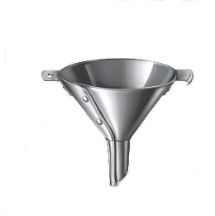
Hazard identification – risk assessment
When a hazard has been identified we need to…
Identify any future/planned control measures that will be introduced to mitigate / modify the risk.
Task
Hazard
Hazard
Hazard
Hazard
Haz.
Review completed Hazard and Risk Register
Planned

Slide 21
Linkage between risk and emergency / crisis management
Crisis
Crisis management
Emergency response
Incidents
Risk controls
Events

Slide 22
Linkage between risk and emergency / crisis management
First responder plans
Emergency management
Crisis management

Slide 23
Linkage between incidents and risk
When an incident occurs, it should be assessed for its
Actual consequence, and
Potential consequence
The potential consequence should dictate the investigation required.

Slide 24
Linkage between incidents and risk
Type of investigation required
Formal investigation e.g. ICAM™/TapRoot™
5 Why/Why Tree
Basic root cause analysis

Slide 25
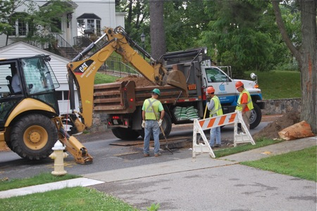
Linkage between incidents and risk
Example…
Backhoe used to excavate access-way. A worker moved into the area under the control of the driver to remove a rock that had fallen back into the work area.
The worker was struck on the head, resulting in minor grazing and bruising.

Slide 26
Linkage between incidents and risk
Actual consequence - First aid = Insignificant
Potential consequence - Single fatality = Major
Investigation type required – ICAM™/TapRoot™

Slide 27
Linkage between incidents and risk
Incident report 3: Consequence = Medical treatment Likelihood = still assessed as once in 5 years
Incident report 4: Consequence = Single fatality Likelihood = Once a year
Incident report 2: Consequence = First aid Likelihood = changed to once in 5 years
Incident report 1: Consequence = First aid Likelihood = changed to once in 10 years
Initial risk assessment: Consequence = First aid Likelihood = once in 50 year event
Whenever the risk classification for an activity increases, this should be highlighted to Senior Management and brought to the attention of the Board through Due Diligence reporting.

Slide 28
Risk provides insights as to where attention should be given
Focus on that which is important as opposed to ‘just interesting’

